Slide 1
Level 100 Magikarp presents…

Slide 2

CHECKERS!

Slide 3
Executive Producers
Kyle Tucker Chris Lee
Taylor Sallee Chaeha Park

Slide 4
Design

Slide 5
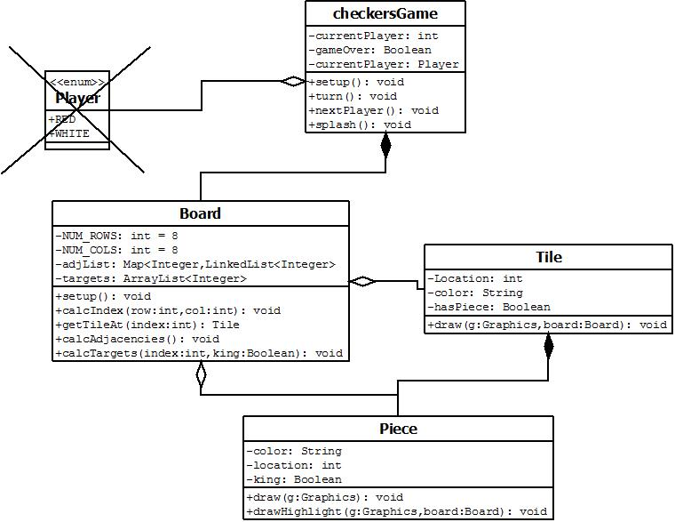

Slide 6
Game Demo

Slide 7
Lessons Learned
Sometimes your original design needs to be changed. We removed the Player class because we found it unnecessary.
Simplicity is best. Unwritten code is error-free code.
Refactoring is important. Removing clutter from existing code makes writing new code much easier.

